Slide 1



FRAUDULENT CREDIT CARDS
TRANSACTIONS
Group 5

Slide 2
Fraud Detection
Désir Chasnick
Fred Junior Noël
Fritz Gerald Junior Valcin
July 02, 2021

Slide 3
Agenda
1. Introduction - Team, Client, Problem
2. Systems Analysis of Problem - Review stakeholders, define measurements of performance
3. Relevant Analytics - Data sources, Analysis
4. Methodology-How did we deal with the subject?
5. Results- What did we find out?
6. Alternative Solutions - Explanation of solutions, comparison of outcomes
7. Recommendations - What should the client do next? What is the recommended next step?
8. Appendix - Additional Resources

Slide 4
Introduction
We are experts in data science, we work with AyitiAnalytics and a bank asked us for our expertise in order to fight against credit card fraud of which its customers are victims.

Slide 5
Systems Analysis of Problem
This problem of credit card fraud affects both the bank because it erodes its image among its customers and lowers its trust capital.
The customers of the bank are affected by the problem because they lose their money directly.
We can measure success in this case by a significant reduction in the number of successful frauds as well as the overall volume of money stolen.
Public perception can also be used to measure the performance of the decisions that the bank will have to make in order to secure the transactions of these customers.

Slide 6
Relevant Analytics
the data was provided to us by the bank.

Slide 7
Methodology
The problem being a financial fraud problem, we had to take the time:
- to understand the context.
- to question the bank.
-to ask him to provide us with his data.
After :Then we used the Python 3 libraries to clean the data, generate graphs, and reveal links between variables.
For this we had to:
- carry out univariate analyzes on the data.
-Process bi- and multivariate analysis by clearly crossing the different variables of the dataset.
- Carry out qi square tests in order to verify the independence of the variables.

Slide 8
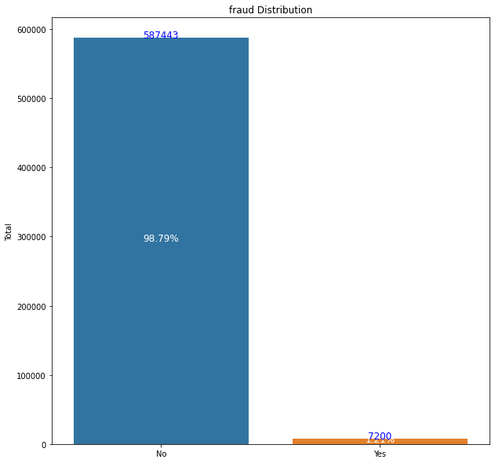
Results
1-Data Fraud Histogram
As we can see from over 594,000 transactions, only around 1.20% are fraud.
The Blue columns is non-fraudulent transaction and yellow column is fraudulent transactions.
This histogram give us simultaneously the number and the relative frequency of this variables.
Please use zoom 200% on this slide.

Slide 9
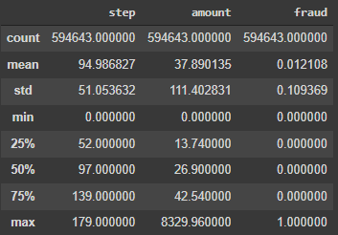
Results
Others descriptive summary
As we can see:
-The average spend is $ 37.89 per transaction.
-The highest transaction exceeds $ 8,200.
- the median of the transaction values ​​is at 26.90 dollars.

Slide 10
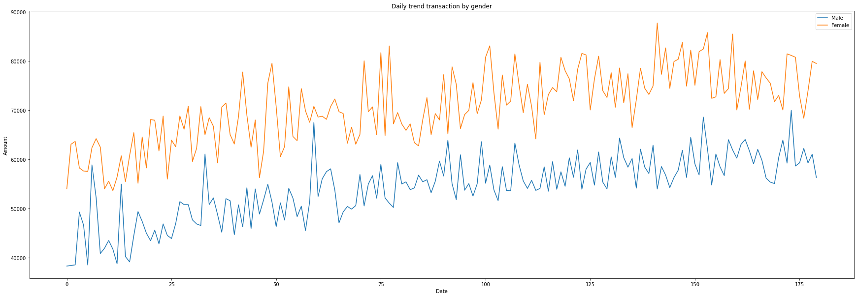
Results
Daily trend transaction by gender
This graph allows us to see that women spend significantly more than men.
It also seems that the expenses of the two have only increased during the 180 days that the dataset covers.
Please zoom at 200% to see clearly the Graph.

Slide 11
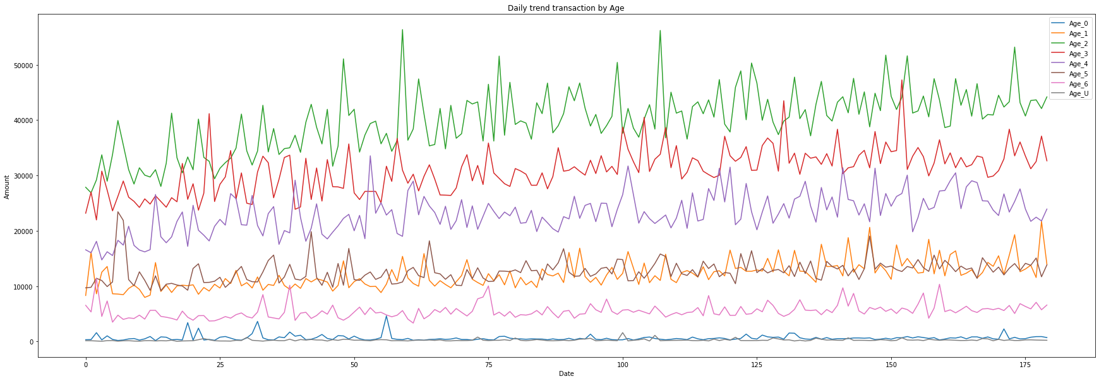
Results
Daily trend of transaction by Age
The group that spends the most are the group 2 followed by those of 3 and 4.
Groups 1 and 5 have practically the same level of consumption.
Groups 1 and 0 are the least spent.

Slide 12
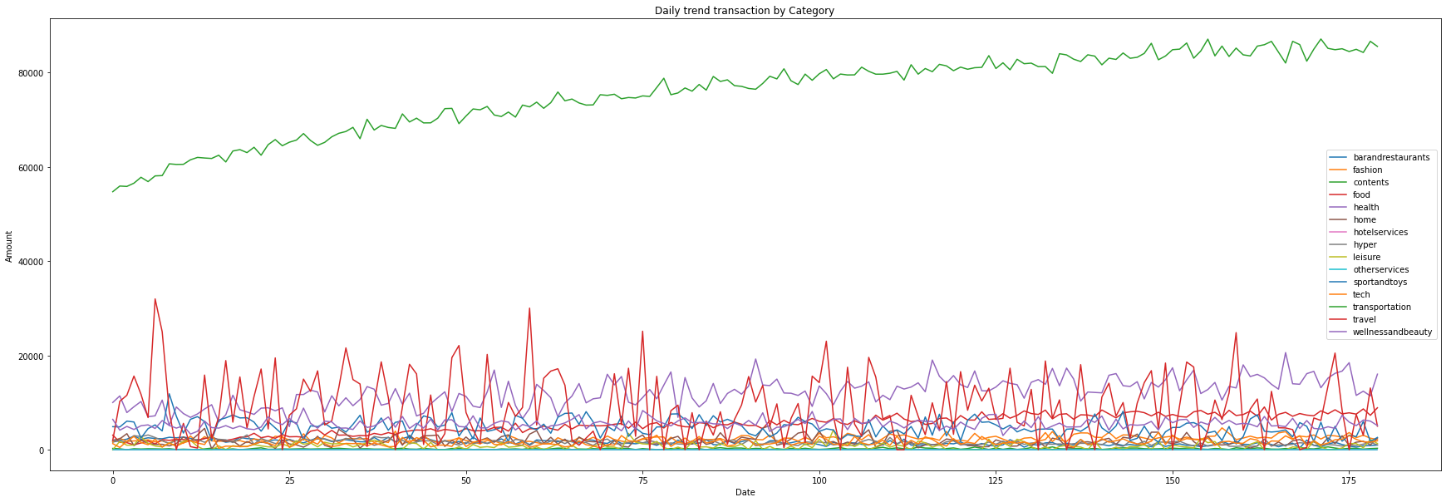
Results
Daily trend transaction by category
As we can see the transportation expense far exceeds the other categories.
Food expenditure periodically experiences peaks and troughs, which can be explained by the purchase of food for a fixed period of consumption.

Slide 13
Discussion & Proposed Solution
What are your thoughts on the fraudulent transactions?
1-We asked ourselves about potential correlations between fraud and different categories of transaction, age or gender. we could see that the probability of fraud is dependent on the different categories.
2-From our pivot table between the fraud and class of amount values, we can see that the amount of fraudulent transactions per class exceeds the amount of non-fraudulent transaction from [277-370] dollars values.
(Please see our repository on Github, link here: ).

Slide 14
Discussion & Proposed Solution
Analysis, allow us to see that most transactions are worth less than $1000.
Much of our fraud is also found in transaction under $1000.
We also notice that Higher is the transactions amount, higher is the probability to being a fraud.
Women are twice as victims of theft than men.This can be explained by the fact that they buy more often and for higher amounts than men.
Paradoxically, we note that spending on sports and games is globally more often the victim than any other category except that is not the category where people spend the most in terms of volumes.This can be explain by unsecured sales sites.

Slide 15
Alternative Solution
We will ask the bank to let us build a machine learning model. Able to predict, detect and report fraud in real time.
This model would be particularly parameterized to delay the validations of any transactions made by women and of a value exceeding 500 dollars in the categories sport and leisure.
The system will have to ask these customers in these categories to reconfirm their transactions before validation.
We will recommend that the bank conduct a study to determine to what level it can improve the security of its electronic payment system.Makes it less vulnerable to hacks.
These solutions could drastically reduce theft complaints. Improve the security feeling of customers abd at the same time boost customer confidence and the bank’s public image.

Slide 16
Alternative Solution
We can notice that the ZipCodes are identical for all customers and all merchants,that means they living at the same geographic zone. yet we assume have to assume that the bank does not only do business there. Additional data on other geographic areas of transactions would be welcome and would help us refine our predictive machine learning model.

Slide 17
References & Appendices
● Github Repository: https://github.com/ChasnickDesir1995/Fraud-Detection-Project.git
● Ayiti Analytics: www.ayitianalytics.org
●https://www.coursera.org/learn/python-for-data-visualization
●https://spd.group/machine-learning/credit-card-fraud-detection/

Slide 18
Team Members
Désir Chasnick
Fred Junior Noël
Fritz Gerald Junior Valcin

Slide 19
Thank you
for you attention
Ressources :

